Slide 1

File System Development :
An Introduction
This presentation introduces a file system development project. It covers the importance of file systems, the project scope, and key objectives. Learn about organizing data, accessing files, and gaining system-level programming experience.
Presented By :-
Ayushi Bindal (1/23/SET/BCS/341)
Diya Sharma (1/23/SET/BCS/347)
Shaurya Karn (1/23/SET/BCS/339)

Slide 2
Design and architect
We have used Python for our File System Development Project as Python simplifies file system development with built-in modules like os and shutil, enabling smooth file and folder operations across Windows, Linux, and Mac.
With concise syntax and automatic error handling, Python ensures faster development while maintaining stability. Its flexibility allows easy upgrades, whether adding a GUI or expanding to a cloud-based system.

Slide 3
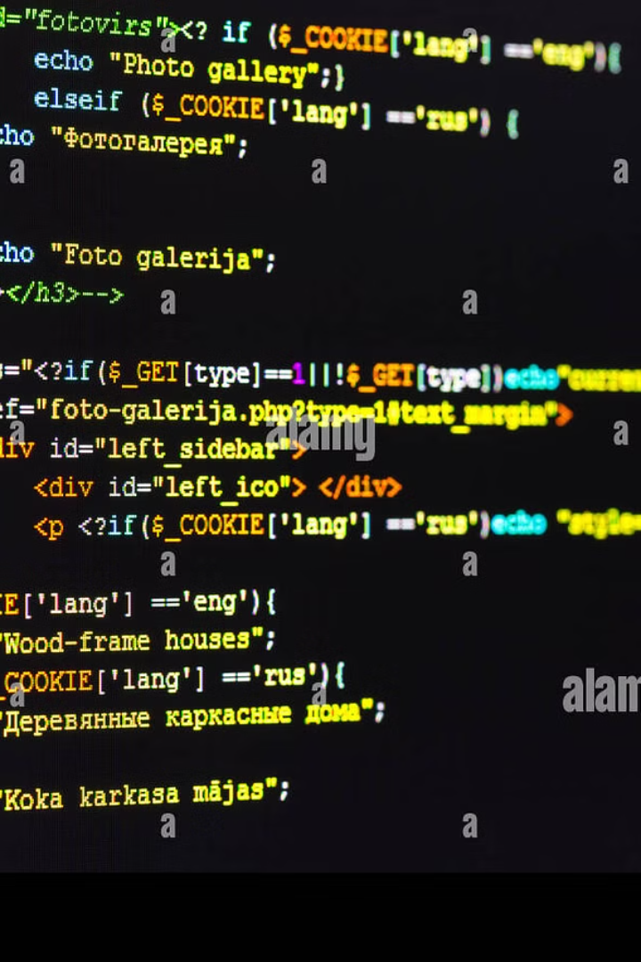
Implementation Details
File Management
Create, read, write, copy, delete, and rename files
Directory Management
Create, list, and delete folders
Error Handling
Displays error messages if a file or folder does not exist
Menu-Driven System
Users can perform operations through a simple menu

Slide 4
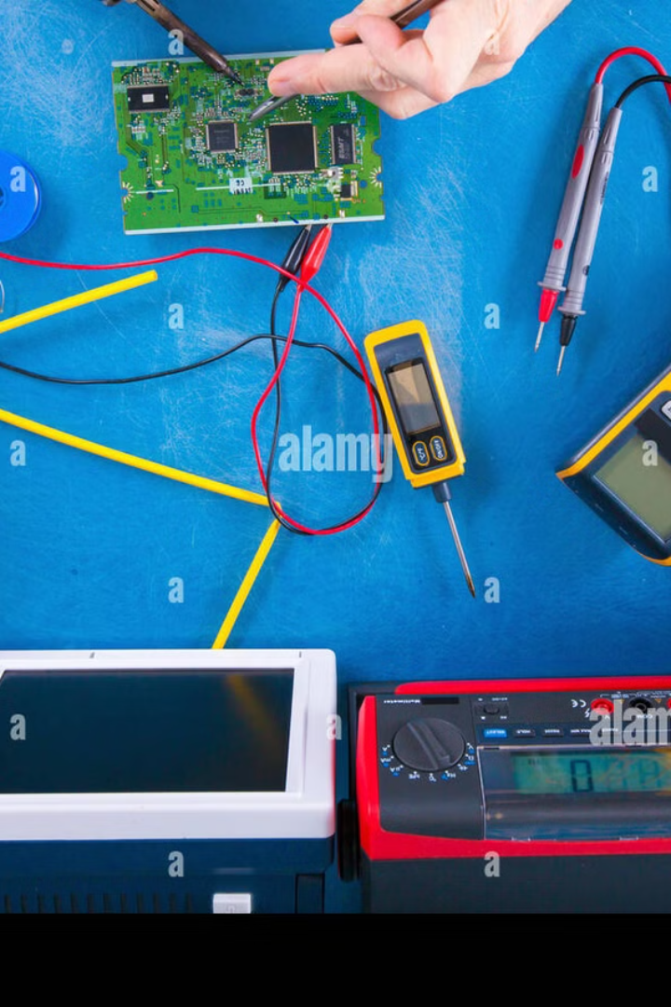



Testing and Evaluation
Testing Strategies
Error handling verification for invalid inputs
Ensuring smooth user interaction via the menu-driven system
Performance Metrics
Efficiency of directory management operations
Handling of large file operations without lag
Future Enhancements
GUI Integration for better user experience and ease of access
Optimized file search and sorting functionalities

Slide 5

This Photo by Unknown Author is licensed under CC BY-SA

